Slide 1
Chapter 5: Graph Databases

Slide 2
With the advent of the NoSQL Databases, businesses have a variety of options from which to build solutions relevant to their use cases:
Calculating average income? Ask a relational database.
Building a shopping cart? Use a key-value Store.
Storing structured product information? Store as a document.
Describing how a user got from point A to point B? Follow a graph.

Slide 3
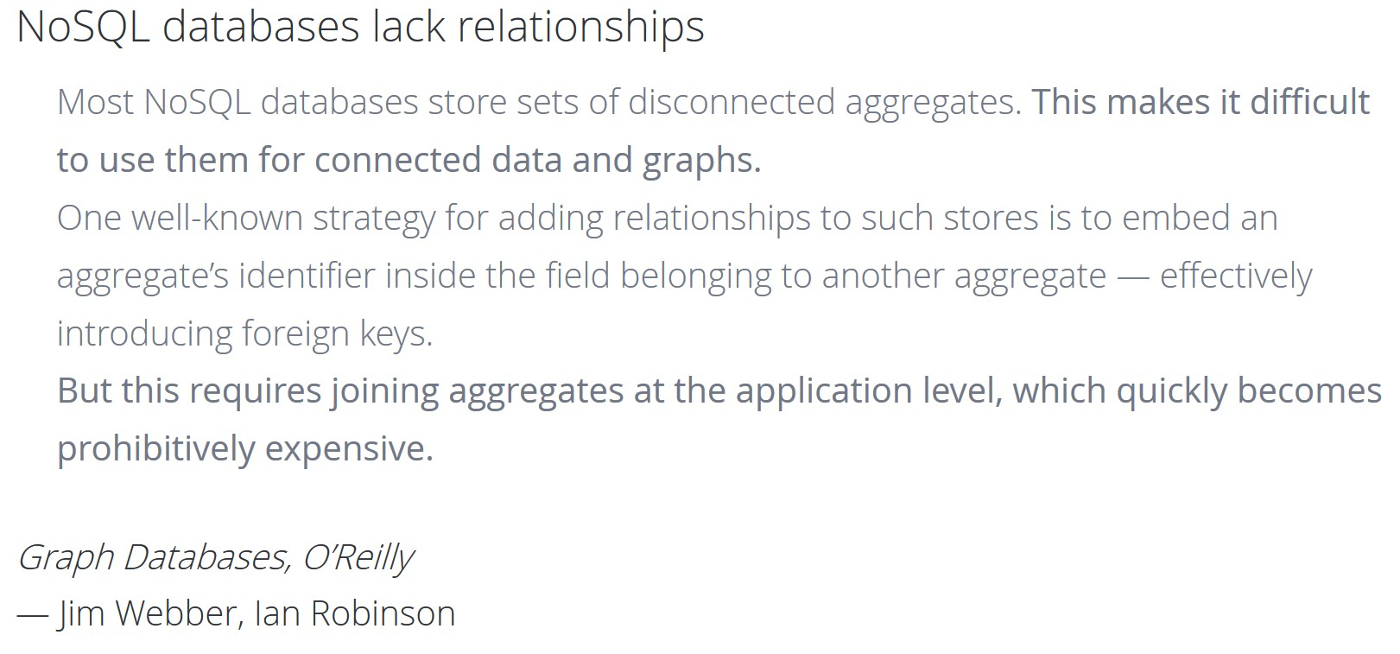

Slide 4
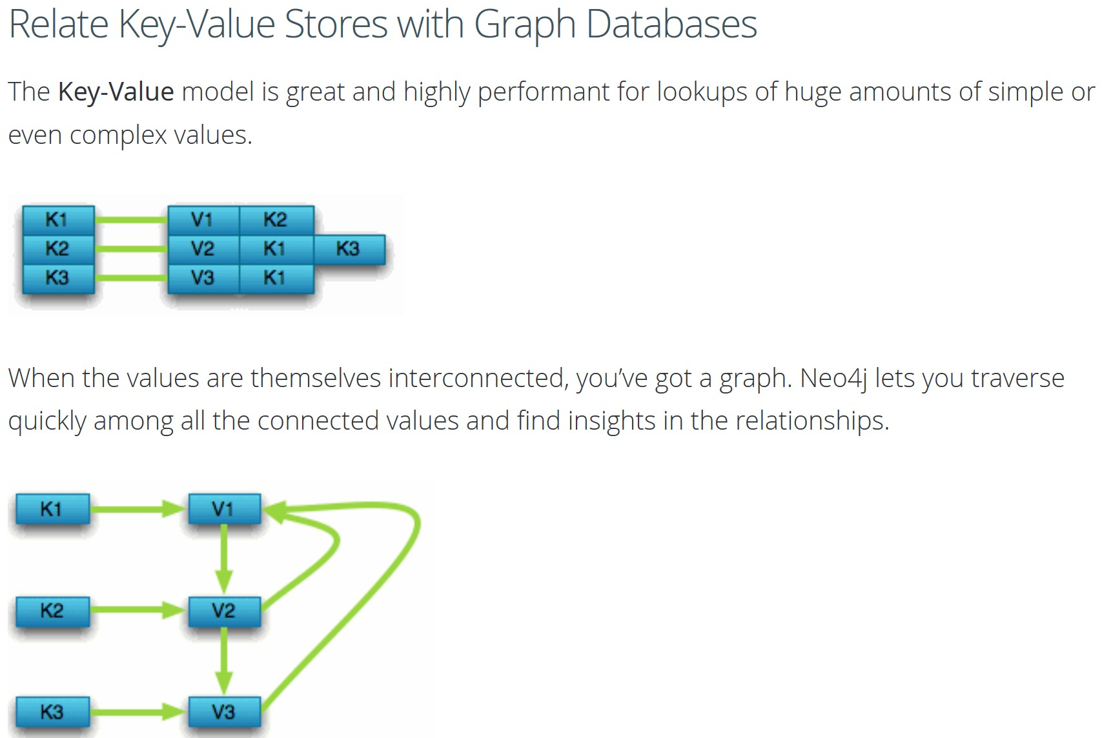

Slide 5
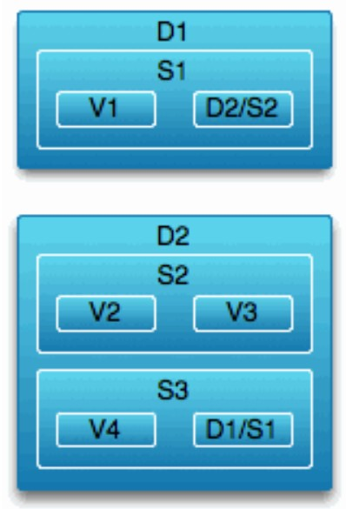
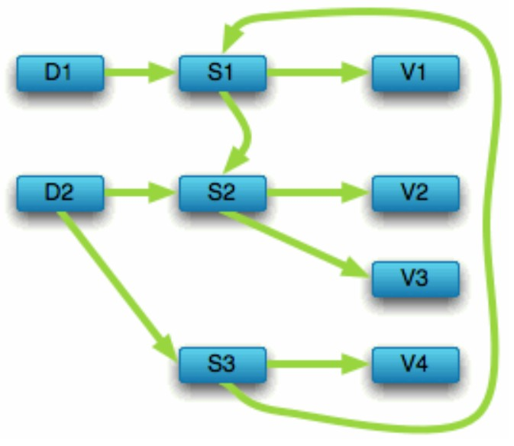
Navigate Document Stores with Graph Databases
The structured hierarchy of a Document accommodates a lot of schema-free data that can easily be represented as a tree. Although trees are a type of graph, a tree represents only one projection of your data. A graph data model lets more than one natural representation emerge dynamically as needed.
Refer to other documents (or contained elements) within that tree and you have a more expressive representation of the same data that you can easily navigate with Neo4j.

Slide 6
Graph Databases
Like the relational database, but unlike many non-relational systems, graph databases are based on a strong theoretical foundation.
Graph theory is a long-established branch of mathematics, with many practical applications in medicine, physics, sociology, and in computer science.
Major components of a graph:
Vertices, or “nodes,” represent distinct objects.
Edges, or “relationships” or “arcs,” connect these objects.
Both vertices and edges can have properties.

Slide 7
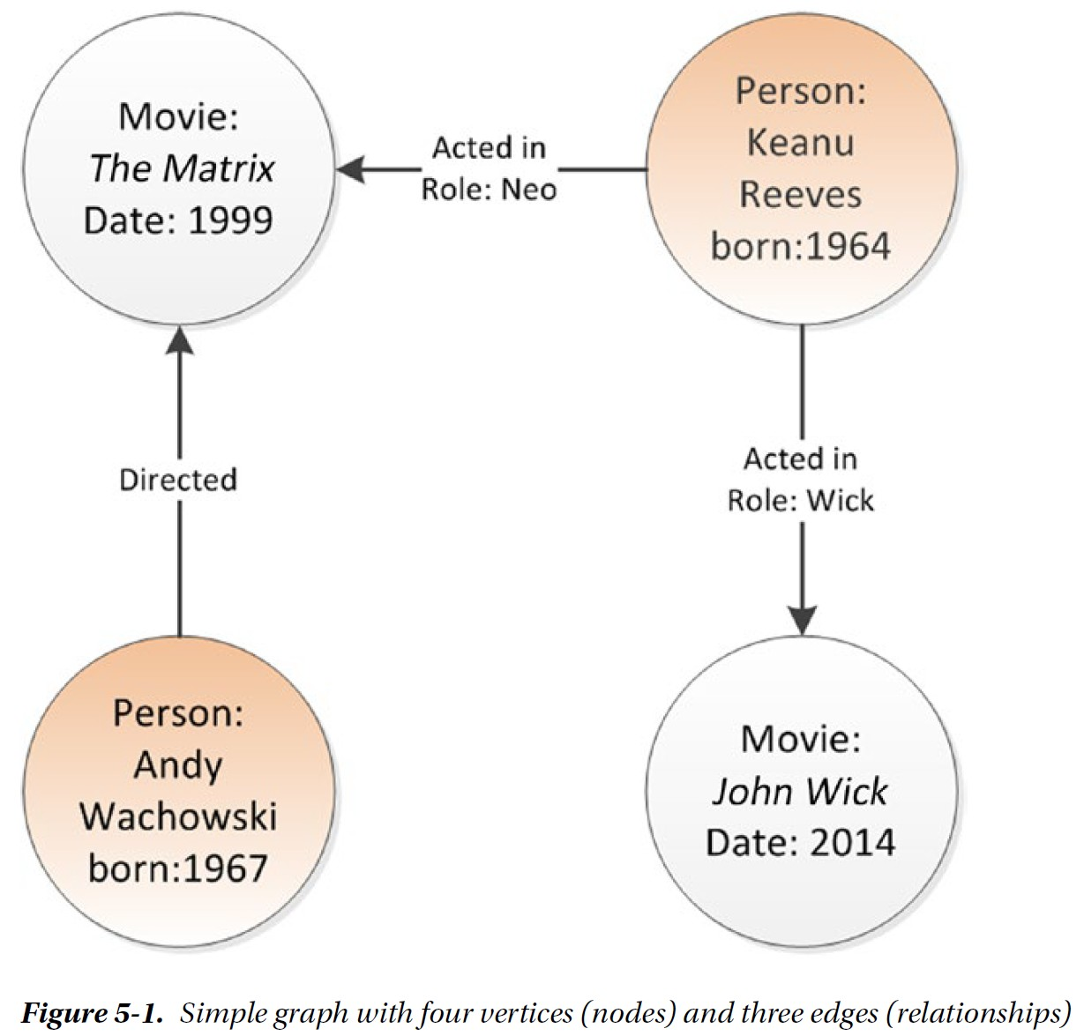
Graph theory provides mathematical notation for defining or removing nodes or relationships from the graph, and for performing operations to find adjacent nodes.
These primitive operations can be used to perform a graph traversal—walking through the graph to explore the network.
For example: find all the actors that have ever appeared as a co-star in a movie starring Keanu Reeves.

Slide 8
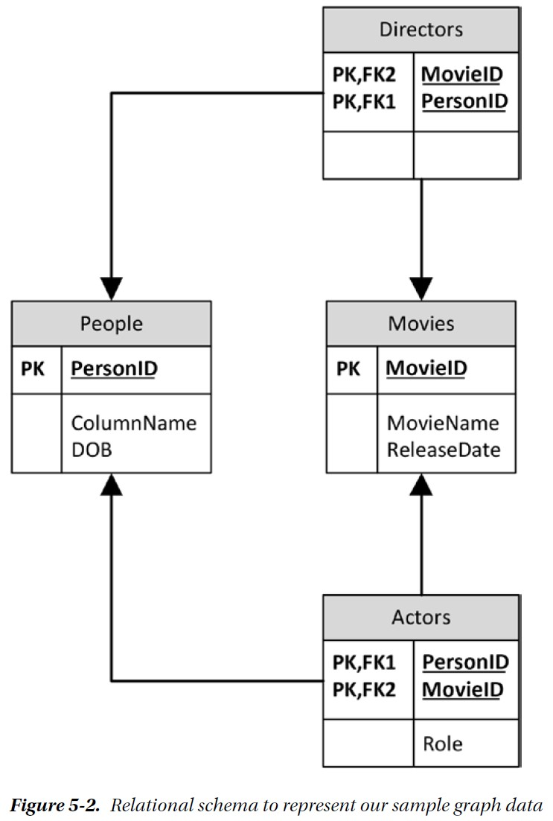
While the relational model can easily represent the data that is contained in a graph model (see Figure 5-2), we face two significant problems in practice:
1. SQL lacks the syntax to easily perform graph traversal. For instance, using SQL to determine
friends of your friends is easy enough, but it is hard to solve the “degrees of separation” problem.
2. Performance degrades quickly as we traverse the graph. Each level of traversal adds significantly to query response time.

Slide 9
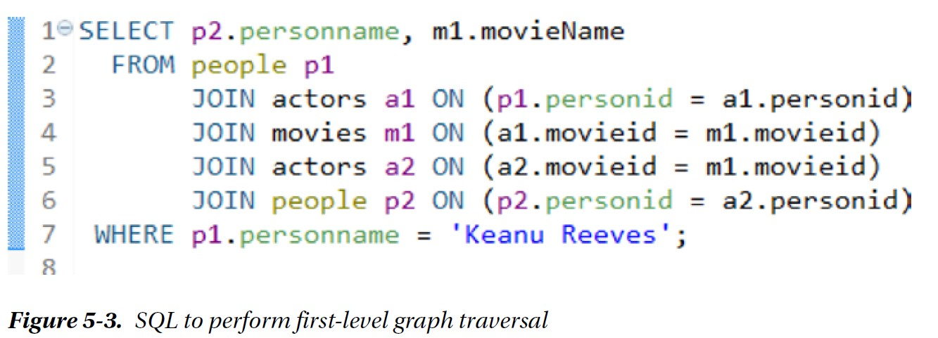
Consider the SQL needed to find all actors who have ever worked with Keanu Reeves (first level graph traversal):
Complex and slow query when increasing the search depth to a second level graph traversal: using SQL, how to find all actors who have ever worked with those actors who have worked with Keanu Reeves? We need to add three more joins and four more tables: actors as a3, movies as m2, actors as a4, people as p3.

Slide 10
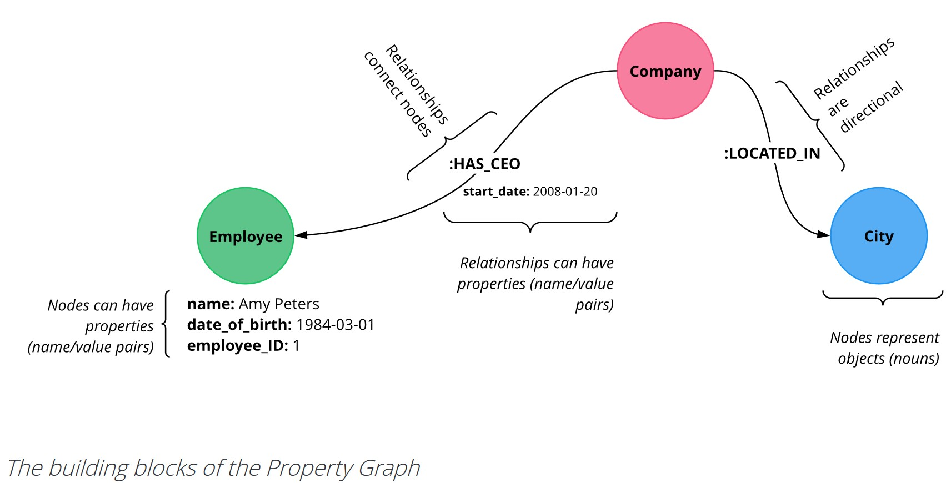
The Property Graph Model

Slide 11
Neo4j
The property graph model is the basis for Neo4j, which is the most widely adopted Java-based graph database.
Neo4J is an open-source NoSQL native graph database that can be easily embedded in any Java application or run as a standalone server.
Neo4j supports billions of nodes and ACID compliant transactions.
Neo4j implements a declarative graph query language Cypher.
Cypher allows graphs to be queried using simple syntax somewhat comparable to SQL, but particularly optimized for graph traversals.

Slide 12
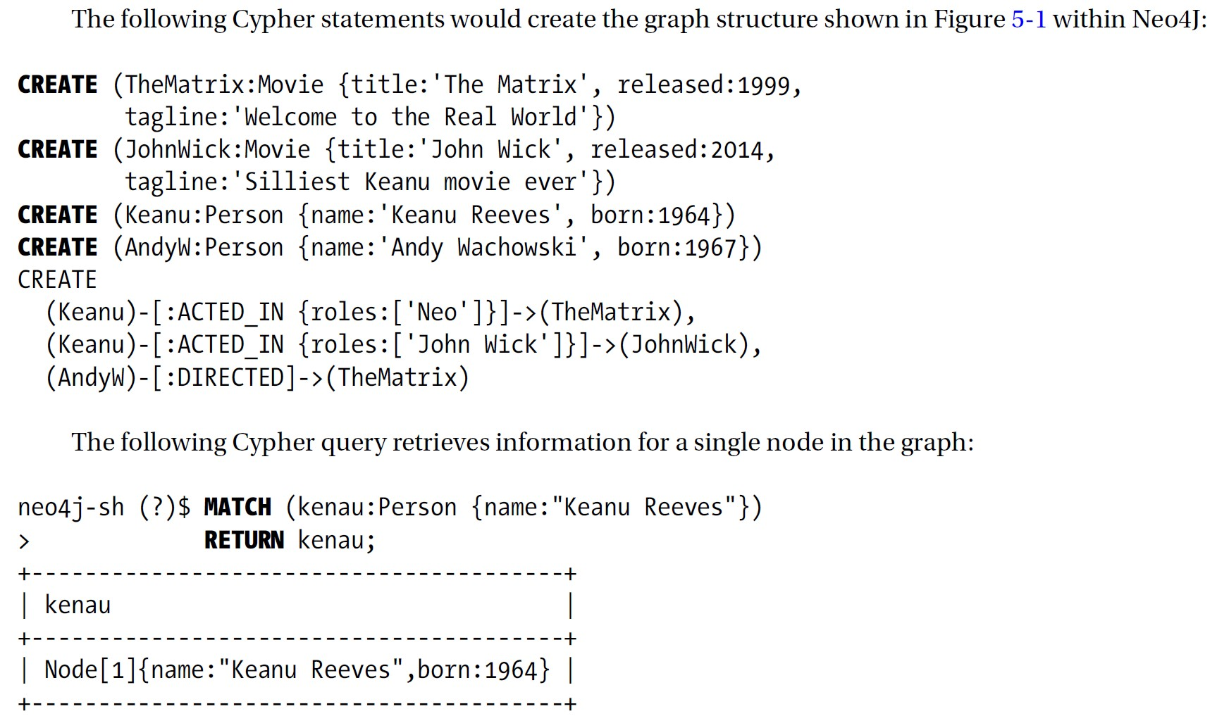

Slide 13
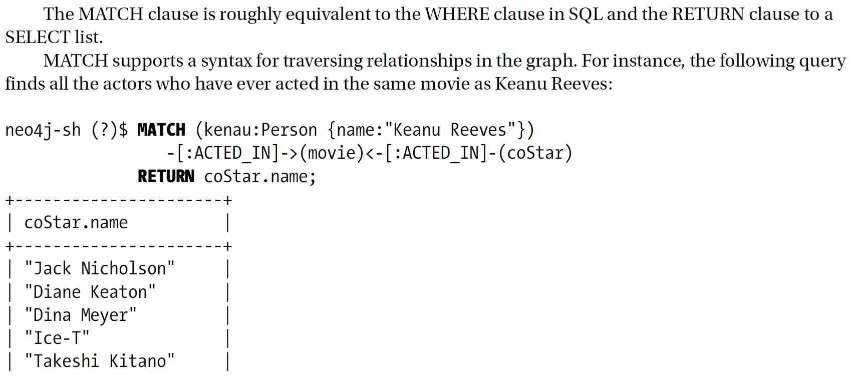

Slide 14
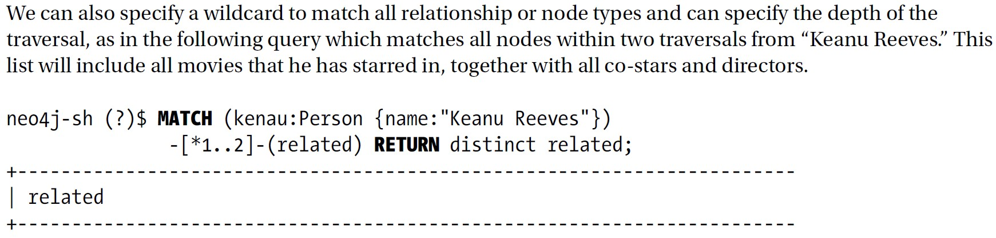
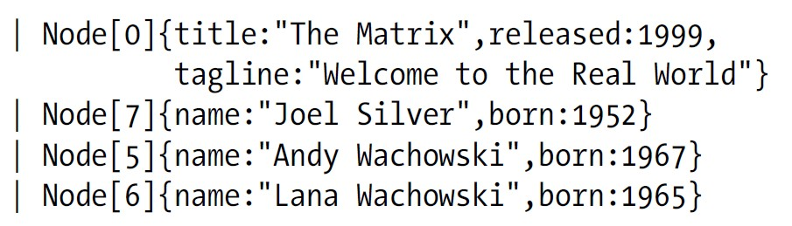

Slide 15
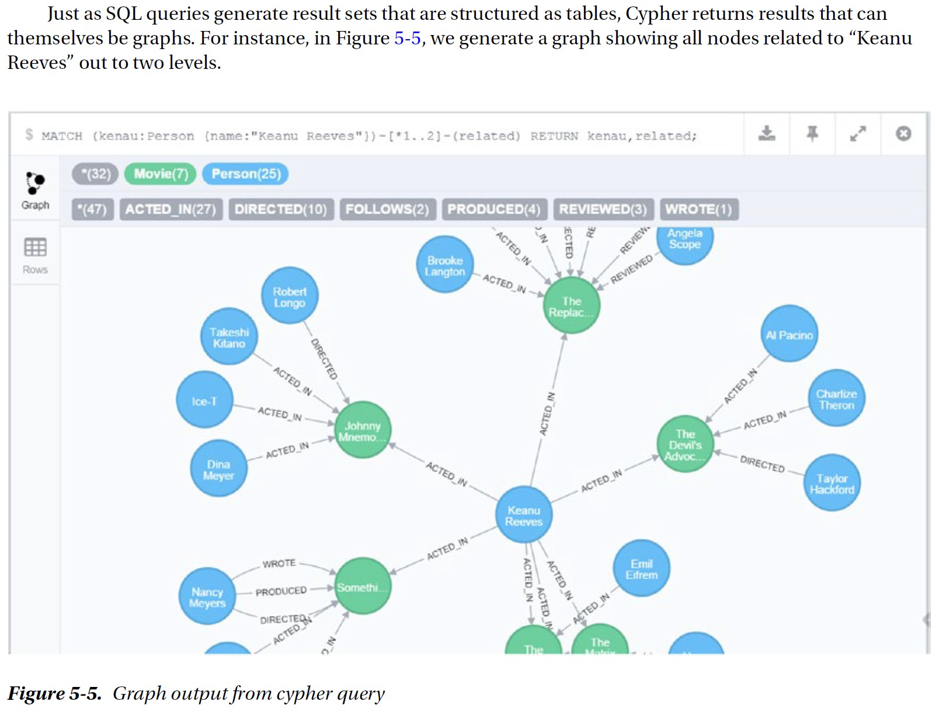

Slide 16
The graph architecture presents challenges for distributing the graph across multiple servers.
While a node can point to an adjacent node located on another machine, the overhead of routing the traversal across multiple distributed machines eliminates the advantages of the graph database model.
For this reason, many pure graph databases like Neo4j do not currently support a distributed deployment—the graph database can run on a single server only.

Slide 17
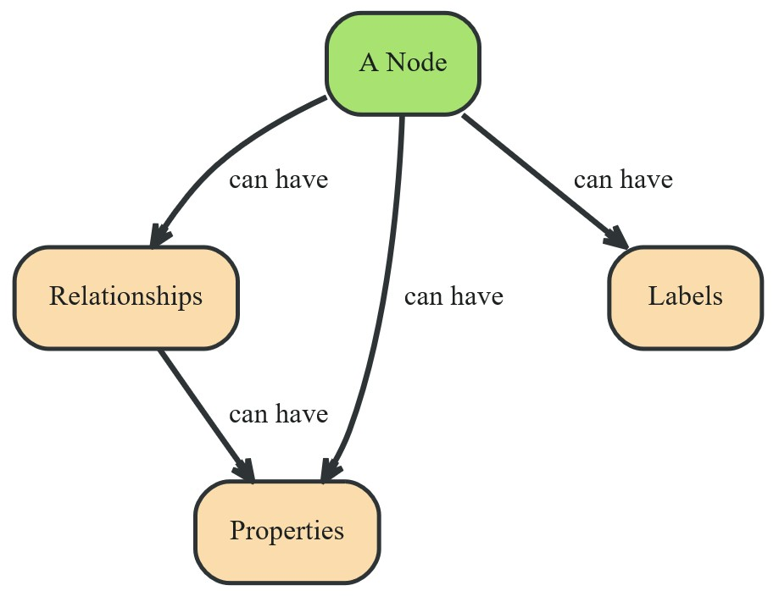
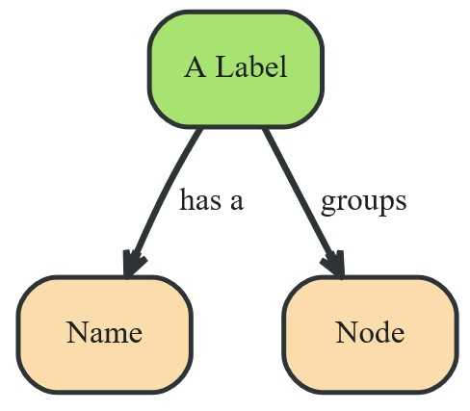
Graph Data Modeling (neo4j.com/developer/guide-data-modeling)

Slide 18
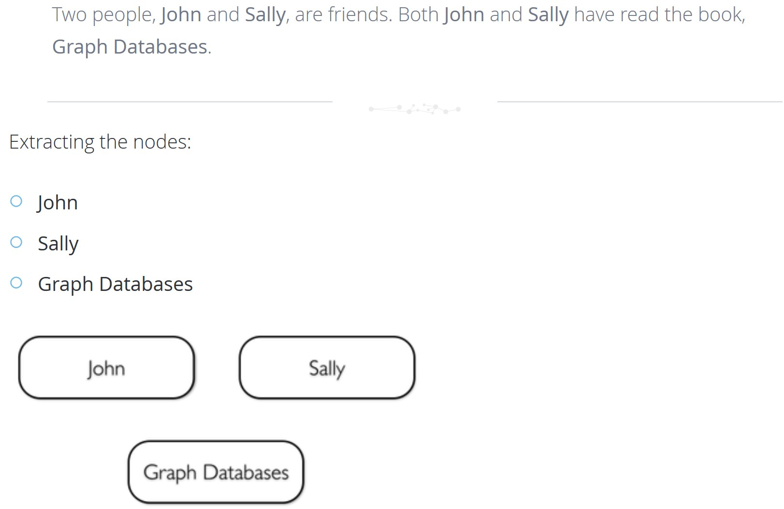
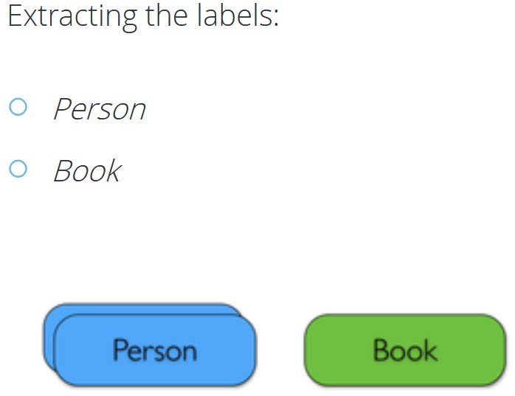

Slide 19
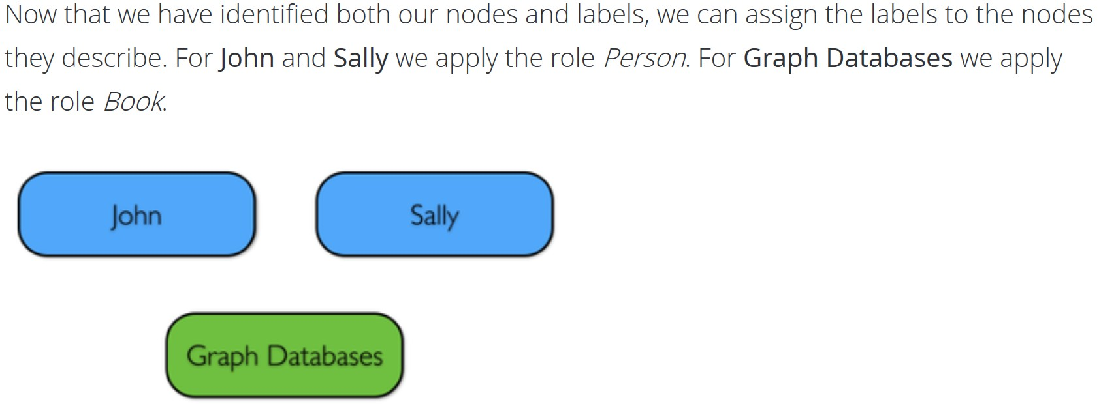

Slide 20
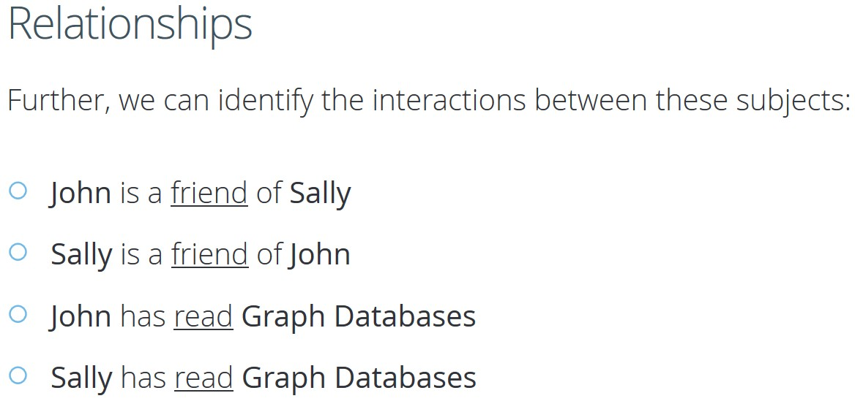

Slide 21
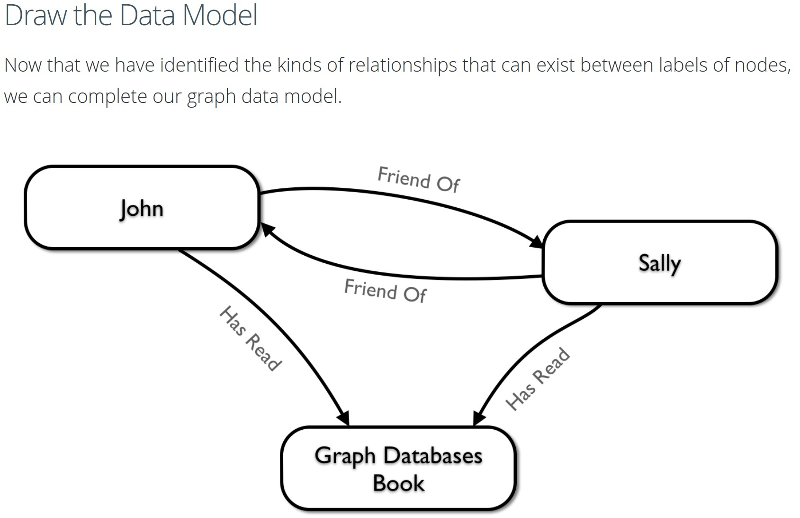

Slide 22
Answering Questions
We have gone through the process of creating a basic graph data model for the interactions between people and books. We can take this data model further by defining attributes of these entities as key-value properties.
List your Questions
First, start by listing your questions that you want to answer about your data.
When did John and Sally become friends?
What is the average rating of the book Graph Databases?
Who is the author of the book Graph Databases?
How old is Sally?
How old is John?
Who is older, Sally or John?
Who read the book Graph Databases first, Sally or John?

Slide 23
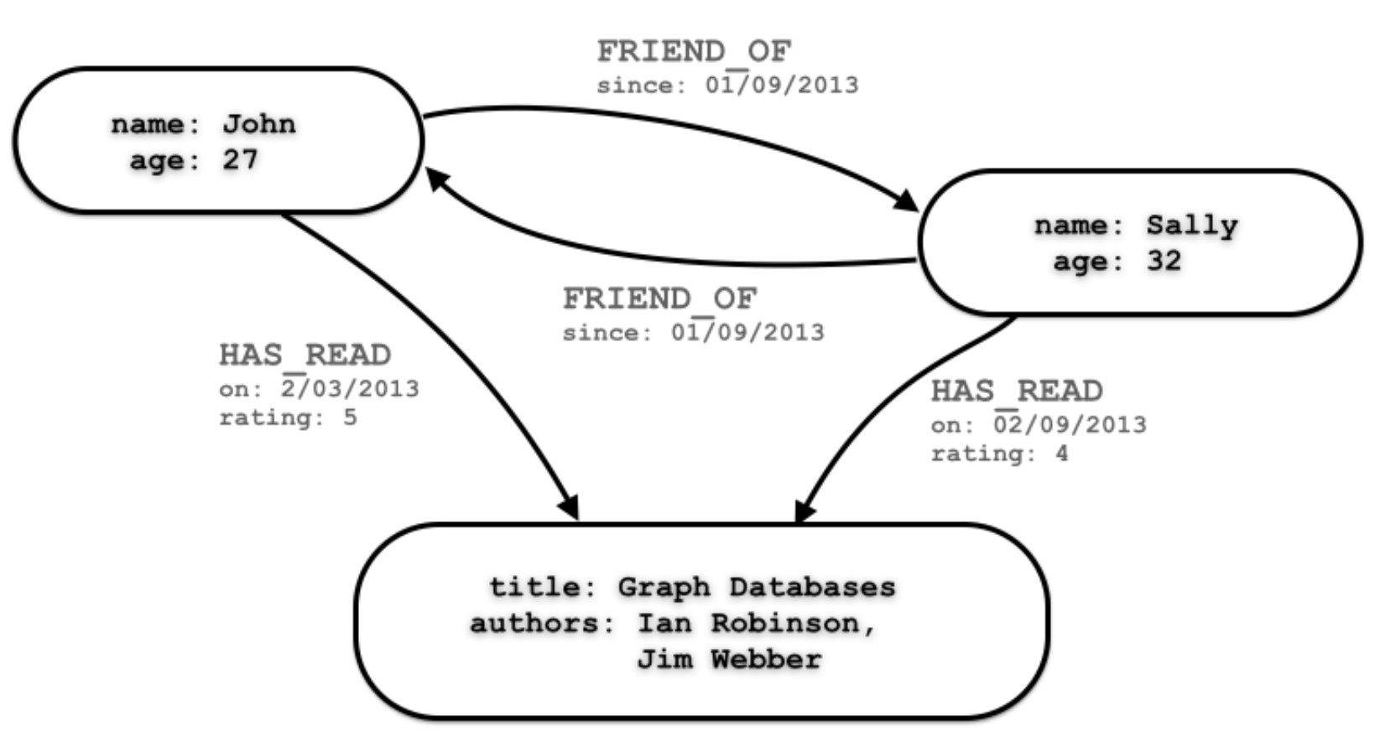

Slide 24
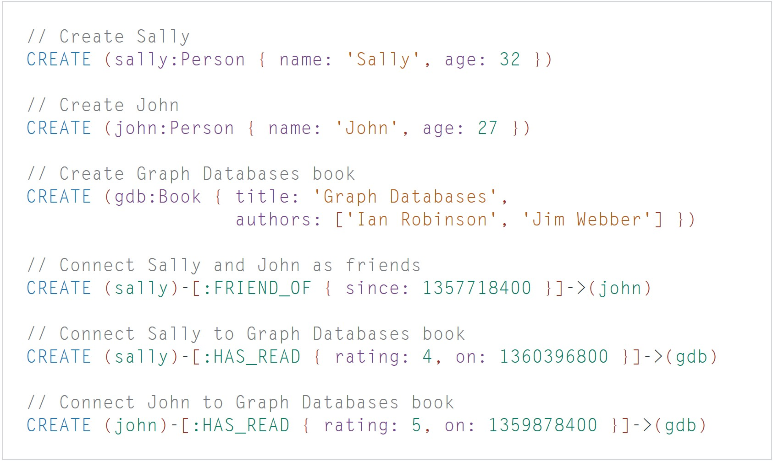

Slide 25
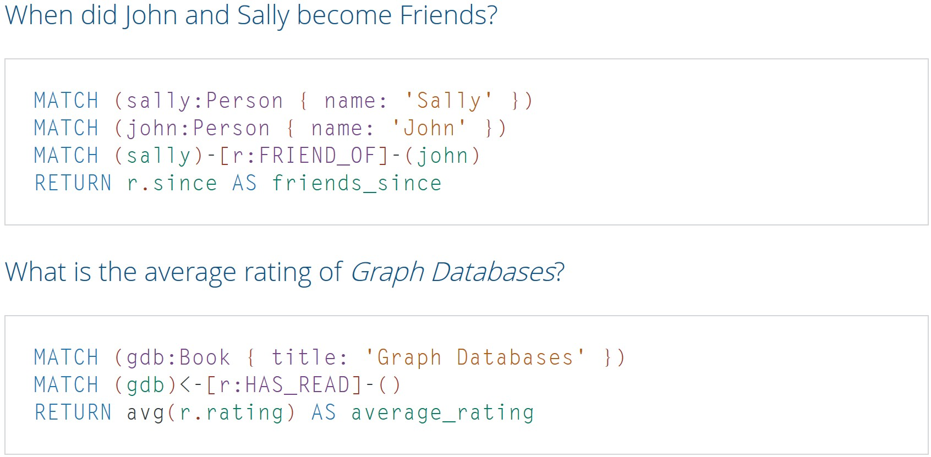

Slide 26
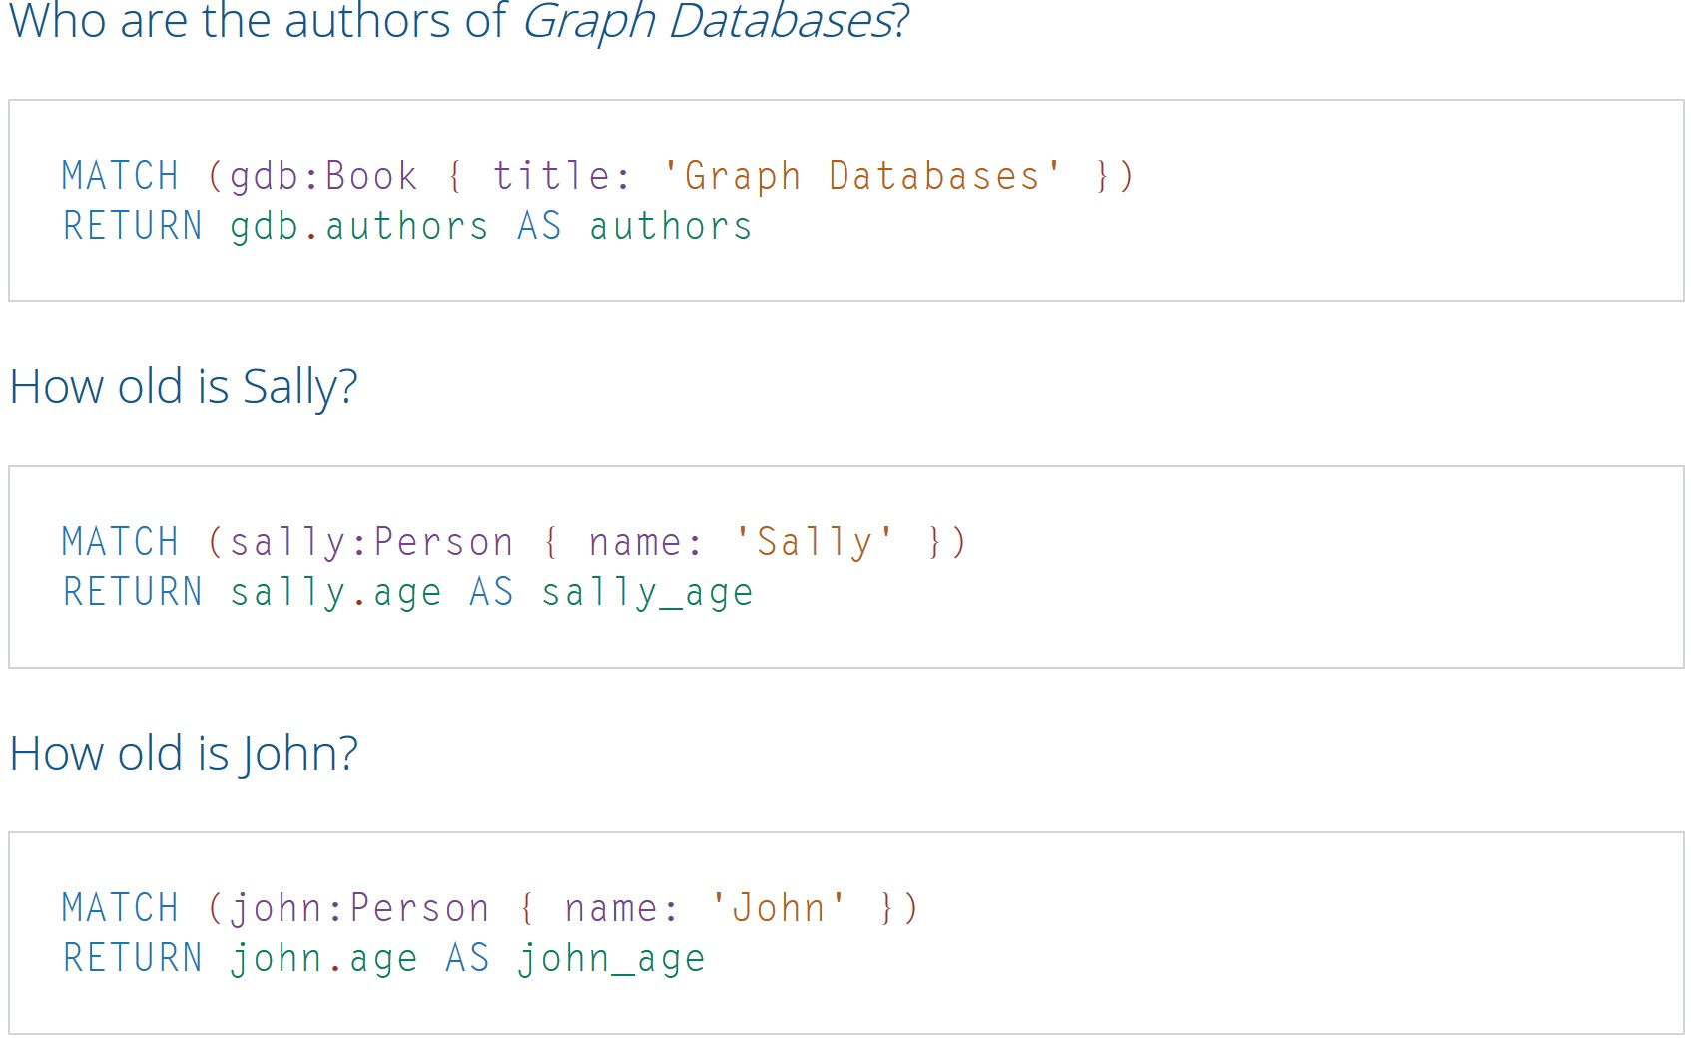

Slide 27
